Slide 1
CS/SE 611 Secure Web Design
Professor Lozada
7:30-10:20PM

Slide 2
Agenda
Roll call
SSO
OAUTH
SAML
OpenID
Project Status Discussion

Slide 3
What is SSO?
Single sign-on is a user/session authentication process that permits a user to enter one name and password in order to access multiple applications. The process authenticates the user for all the applications they have been given rights to and eliminates further prompts when they switch applications during a particular session.

Slide 4
What is OAuth?
OAuth is a standard that apps can use to provide client applications with “secure delegated access”.
OAuth works over HTTPS and authorizes devices, APIs, servers, and applications with access tokens rather than credentials.
OAuth is not an API or a service: it’s an open standard for authorization and anyone can implement it.
There are two versions of OAuth: OAuth 1.0 and OAuth 2.0. These specifications are completely different from one another, and cannot be used together: there is no backwards compatibility between them.

Slide 5
SSO & OAuth difference
OAuth is not the same thing as Single Sign On (SSO). While they have some similarities — they are very different. OAuth is an authorization protocol. SSO is a high-level term used to describe a scenario in which a user uses the same credentials to access multiple domains

Slide 6
What is SAML
SAML (Security Assertion Markup Language) is basically a session cookie in your browser that gives you access to webapps. It’s limited in the kinds of device profiles and scenarios you might want to do outside of a web browser.
When SAML 2.0 was launched in 2005, it made sense. However, a lot has changed since then. Now we have modern web and native application development platforms. There are Single Page Applications (SPAs) like Gmail/Google Inbox, Facebook, and Twitter. They have different behaviors than your traditional web application, because they make AJAX (background HTTP calls) to APIs. Mobile phones make API calls too, as do TVs, gaming consoles, and IoT devices. SAML SSO isn’t particularly good at any of this.

Slide 7
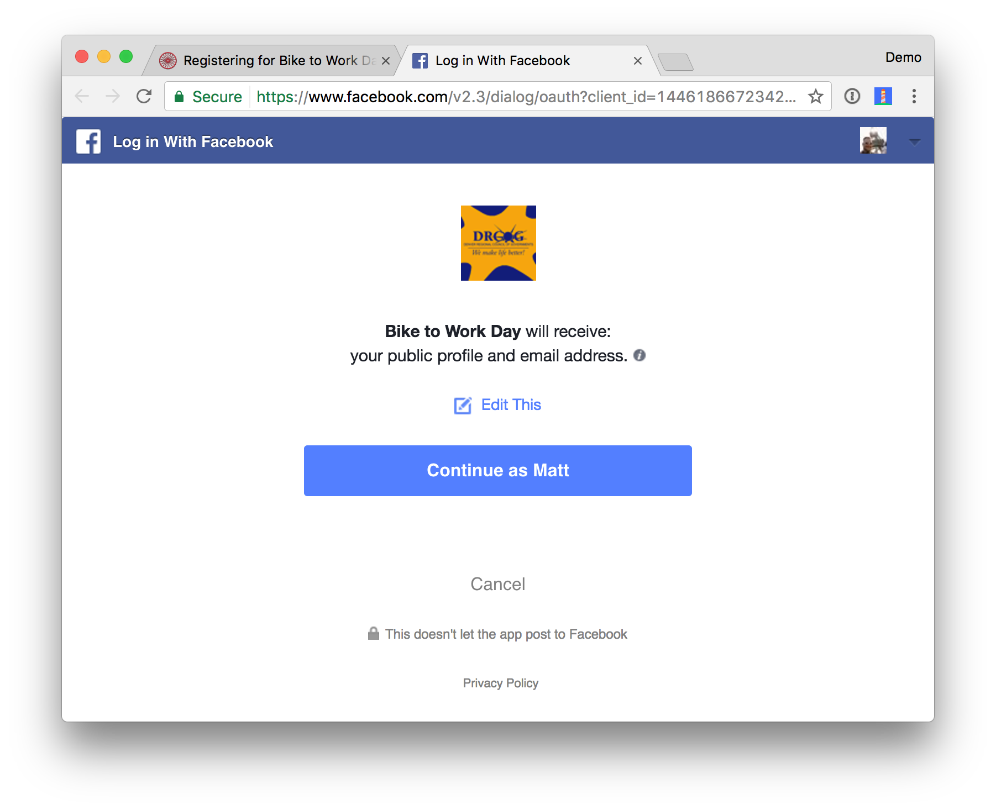
OAuth & APIs
A lot has changed with the way we build APIs too. Now, most developers have moved to REST and stateless APIs. REST is, in a nutshell, HTTP commands pushing JSON packets over the network.
Developers build a lot of APIs. The API Economy is a common buzzword you might hear in boardrooms today. Companies need to protect their REST APIs in a way that allows many devices to access them. In the old days, you’d enter your username/password directory and the app would login directly as you. This gave rise to the delegated authorization problem.
“How can I allow an app to access my data without necessarily giving it my password?”
If you’ve ever seen one of the dialogs below, that’s what we’re talking about. This is an application asking if it can access data on your behalf.

Slide 8
OAuth Continued
OAuth is a delegated authorization framework for REST/APIs. It enables apps to obtain limited access (scopes) to a user’s data without giving away a user’s password. It decouples authentication from authorization and supports multiple use cases addressing different device capabilities. It supports server-to-server apps, browser-based apps, mobile/native apps, and consoles/IoTs.
Basically OAuth is where:
App requests authorization from User
User authorizes App and delivers proof
App presents proof of authorization to server to get a Token
Token is restricted to only access what the User authorized for the specific App

Slide 9
OAuth Components
OAuth is built on the following central components:
Scopes and Consent
Actors
Clients
Tokens
Authorization Server
Flows

Slide 10
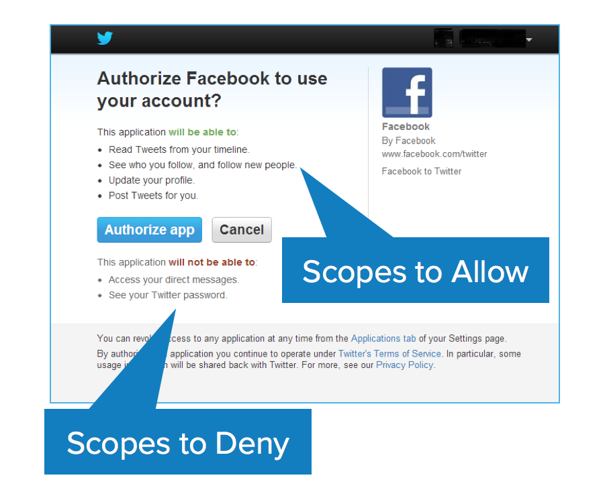
OAuth Scopes
Scopes are what you see on the authorization screens when an app requests permissions. They’re bundles of permissions asked for by the client when requesting a token. These are coded by the application developer when writing the application.

Slide 11
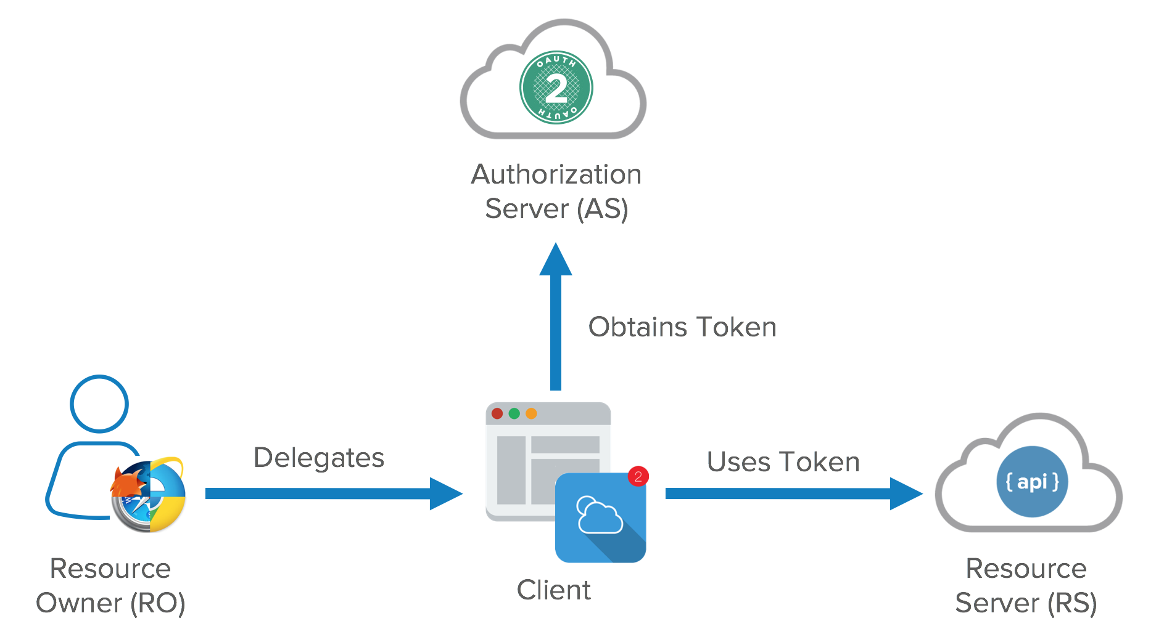
OAuth Actors
There are four primary actors in OAuth:
Resource Owner: owns the data in the resource server. For example, I’m the Resource Owner of my Facebook profile.
Resource Server: The API which stores data the application wants to access
Client: the application that wants to access your data
Authorization Server: The main engine of OAuth

Slide 12
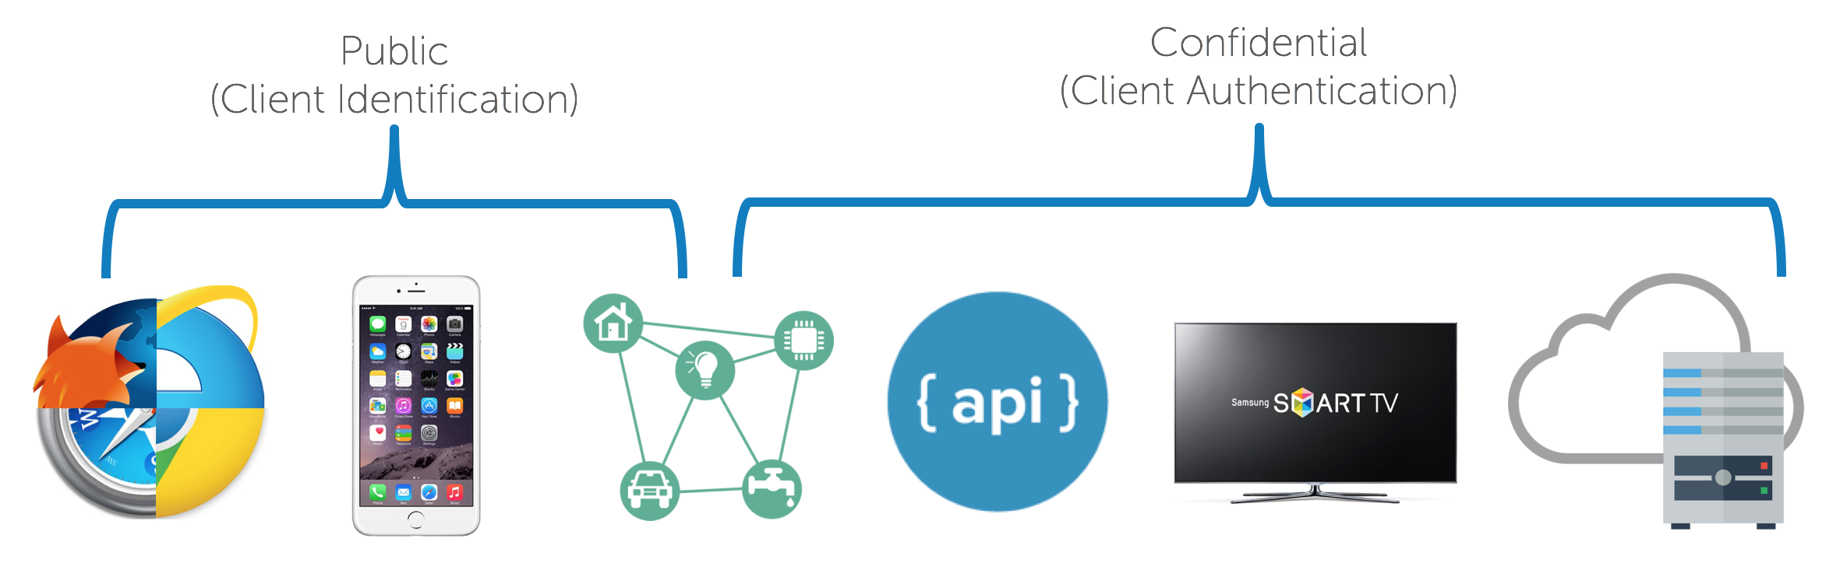
OAuth Actors Continued
The resource owner is a role that can change with different credentials. It can be an end user, but it can also be a company.
Clients can be public and confidential. There is a significant distinction between the two in OAuth nomenclature. Confidential clients can be trusted to store a secret. They’re not running on a desktop or distributed through an app store. People can’t reverse engineer them and get the secret key. They’re running in a protected area where end users can’t access them.
Public clients are browsers, mobile apps, and IoT devices.

Slide 13
OAuth Tokens
OAuth has two types of tokens :
Access Tokens: These are tokens that are presented to the API and are short lived (hours and minutes).
Refresh Tokens: These are used by the client to get a new access token from the Asand are longer-lived. (days, months, years).

Slide 14
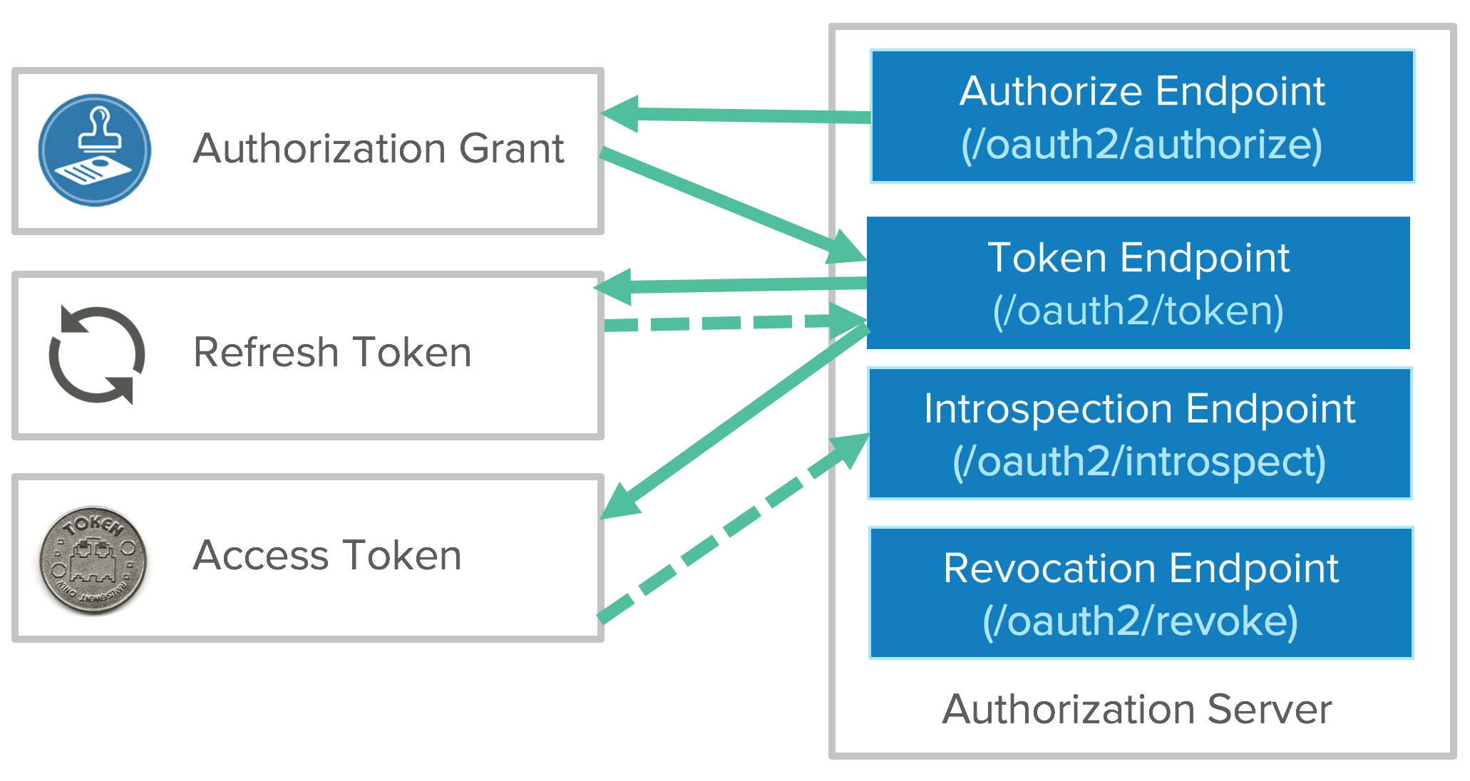
Passing Tokens
Tokens are retrieved from endpoints on the authorization server.
The two main endpoints are the authorize endpoint and the token endpoint. They’re separated for different use cases.
The authorize endpoint is where you go to get consent and authorization from the user. This returns an authorization grant that says the user has consented to it.
Then the authorization is passed to the token endpoint. The token endpoint processes the grant and says “great, here’s your refresh token and your access token”.

Slide 15
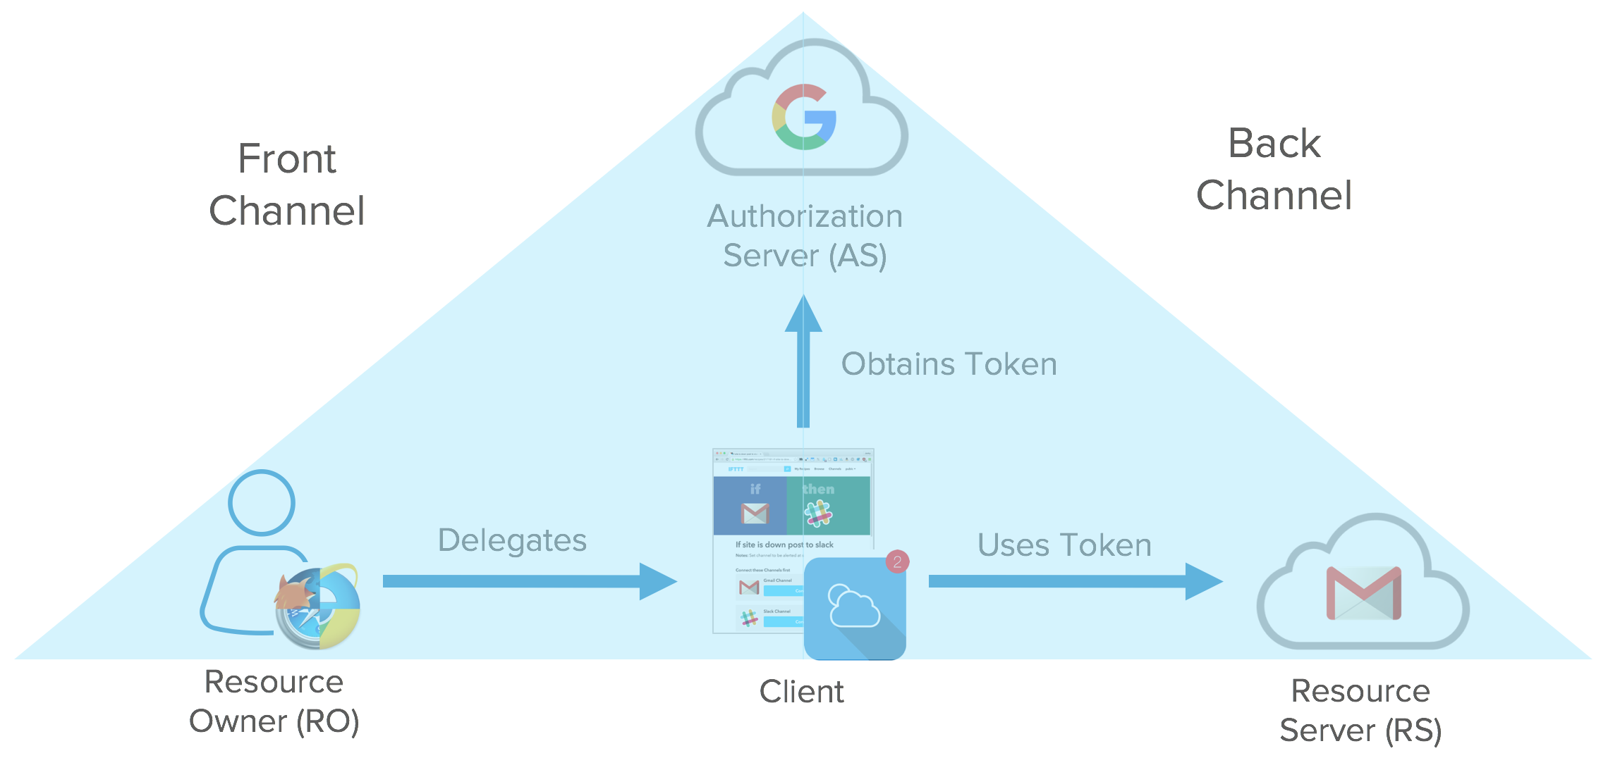
OAuth Flows – Front Channel & Back Channel
Resource Owner starts flow to delegate access to protected resource
Client sends authorization request with desired scopes via browser redirect to the Authorize Endpoint on the Authorization Server
Authorization Server returns a consent dialog saying “do you allow this application to have access to these scopes?” Of course, you’ll need to authenticate to the application, so if you’re not authenticated to your Resource Server, it’ll ask you to login. If you already have a cached session cookie, you’ll just see the consent dialog box. View the consent dialog, and agree.
The authorization grant is passed back to the application via browser redirect. This all happens on the front channel.

Slide 16
OAuth Flows
Implicit Flow - All the communication is happening through the browser. There is no backend server redeeming the authorization grant for an access token. An SPA (Single Page Application) is a good example of this flow’s use case.
Implicit flow is optimized for browser-only public clients.
An access token is returned directly from the authorization request (front channel only). It typically does not support refresh tokens.
It assumes the Resource Owner and Public Client are on the same device. Since everything happens on the browser, it’s the most vulnerable to security threats.

Slide 17
OAuth Flows Continued
Authorization Code Flow - Uses both the front channel and the back channel.
The front channel flow is used by the client application to obtain an authorization code grant. The back channel is used by the client application to exchange the authorization code grant for an access token (and optionally a refresh token).
It assumes the Resource Owner and Client Application are on separate devices. It’s the most secure flow because you can authenticate the client to redeem the authorization grant, and tokens are never passed through a user-agent.

Slide 18
OAuth Flows Continued
Client Credential Flow - In this scenario, the client application is a confidential client that’s acting on its own, not on behalf of the user.
It’s more of a service account type of scenario. All you need is the client’s credentials to do the whole flow. It’s a back channel only flow to obtain an access token using the client’s credentials.
It supports shared secrets or assertions as client credentials signed with either symmetric or asymmetric keys.
Symmetric-key algorithms are cryptographic algorithms that allow you to decrypt anything, as long as you have the password. This is often found when securing PDFs or .zip files.
Public key cryptography, or asymmetric cryptography, is any cryptographic system that uses pairs of keys: public keys and private keys. Public keys can be read by anyone, private keys are sacred to the owner.
This allows data to be secure without the need to share a password.
Mainly Used for Server to Server scenario

Slide 19
OAuth Flows Continued
Resource Owner Password Flow - In this flow, you send the client application a username and password and it returns an access token from the Authorization Server.
It typically does not support refresh tokens and it assumes the Resource Owner and Public Client are on the same device. For when you have an API that only wants to speak OAuth, but you have old-school clients to deal with.
Assertion Flow - Similar to the client credential flow. This was added to open up the idea of federation.
This flow allows an Authorization Server to trust authorization grants from third parties such as SAML IdP.
The Authorization Server trusts the Identity Provider.
The assertion is used to obtain an access token from the token endpoint.
This is great for companies that have invested in SAML or SAML-related technologies and allow them to integrate with OAuth. Because SAML assertions are short-lived, there are no refresh tokens in this flow and you have to keep retrieving access tokens every time the assertion expires.

Slide 20
OAuth Flows Continued
Device Flow (NOT IN THE OAuth SPEC) - There’s no web browser, just a controller for something like a TV.
A user code is returned from an authorization request that must be redeemed by visiting a URL on a device with a browser to authorize.
A back channel flow is used by the client application to poll for authorization approval for an access token and optionally a refresh token. Also popular for CLI clients.

Slide 21
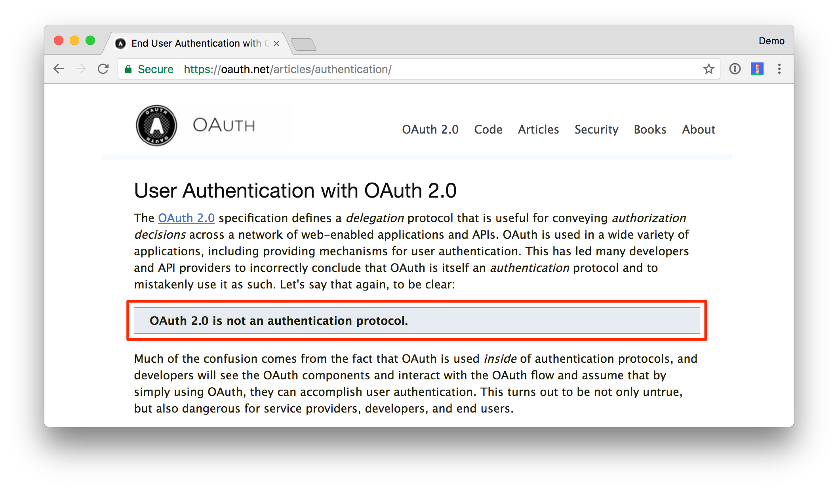
OAuth not an Authentication Protocol
OAuth is an authorization framework and not a protocol
OAuth is about delegated authorization this whole time. It’s not about authenticating the user, and this is key.
OAuth 2.0 alone says absolutely nothing about the user you just have a token to get access to a resource.

Slide 22
Pseudo-Authentication with OAuth
Login with OAuth was made famous by Facebook Connect and Twitter. In this flow, a client accesses a /me endpoint with an access token. All it says is that the client has access to the resource with a token. People invented this fake endpoint as a way of getting back a user profile with an access token. It’s a non-standard way to get information about the user.
What you’re really trying to answer with authentication is who the user is, when did the user authenticate, and how did the user authenticate. You can answer typically answer these questions with SAML assertions, not with access tokens and authorization grants. That’s why we call this pseudo authentication.

Slide 23
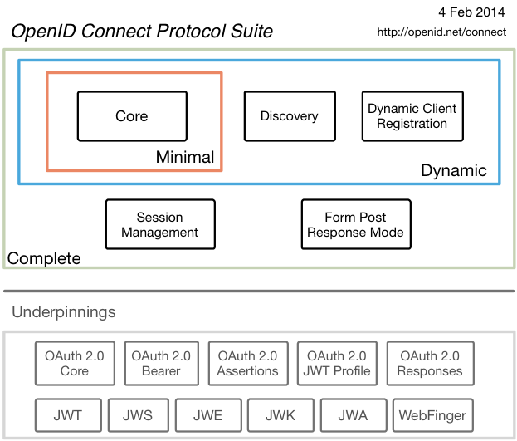
OpenID Connect
To solve the pseudo authentication problem, the best parts of OAuth 2.0, Facebook Connect, and SAML 2.0 were combined to create OpenID Connect.
OpenID Connect (OIDC) extends OAuth 2.0 with a new signed id_token for the client and a UserInfo endpoint to fetch user attributes. Unlike SAML, OIDC provides a standard set of scopes and claims for identities. Examples include: profile, email, address, and phone.
OIDC was created to be internet scalable by making things completely dynamic. There’s no longer downloading metadata and federation like SAML requires. There’s built-in registration, discovery, and metadata for dynamic federations. You can type in your email address, then it dynamically discovers your OIDC provider, dynamically downloads the metadata, dynamically knows what certs it’s going to use, and allows BYOI (Bring Your Own Identity).
It supports high assurance levels and key SAML use cases for enterprises.
OIDC was made famous by Google and Microsoft, both big early adopters.

Slide 24
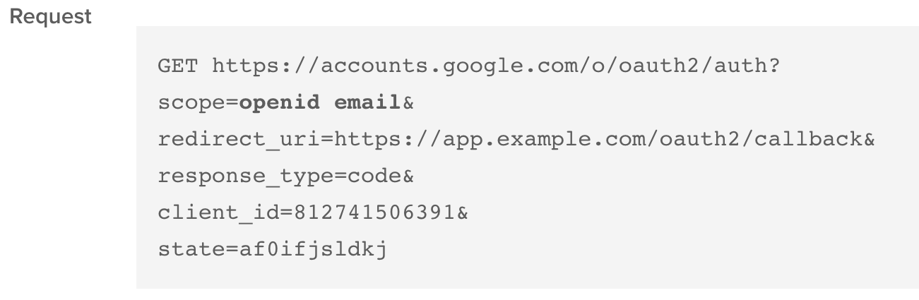
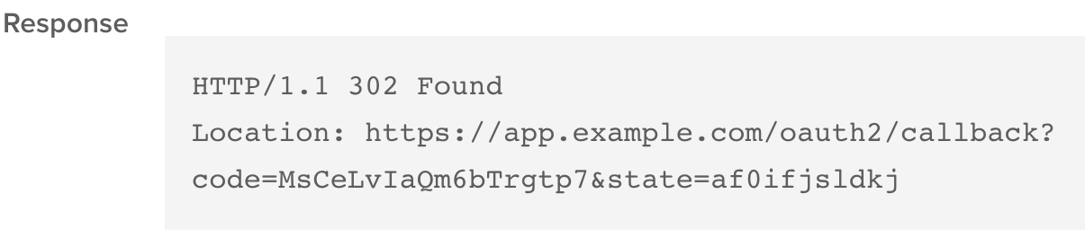
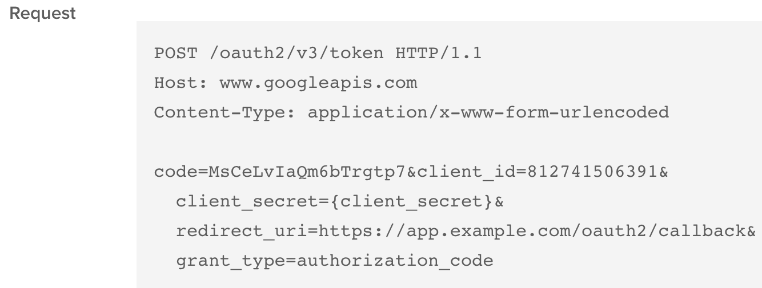
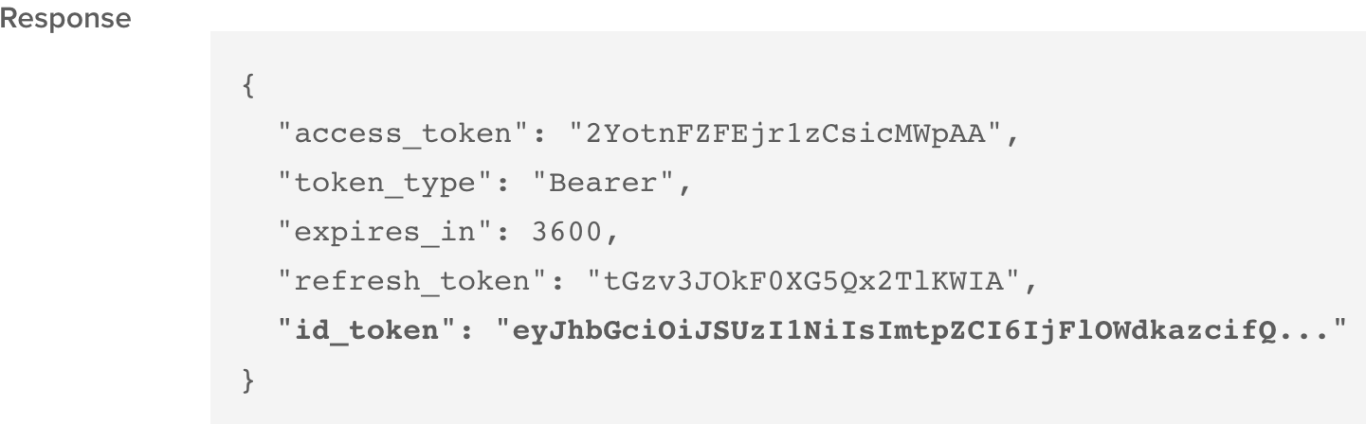
OIDC
All that changes in the initial request is it contains standard scopes (like openid and email):
The code returned is the authorization grant and state is to ensure it's not forged and it's from the same request.
And the authorization grant for tokens response contains an ID token.

Slide 25
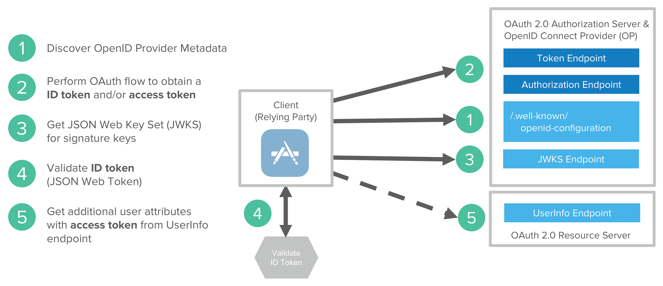
Open ID Connect flow
Discover OIDC metadata
Perform OAuth flow to obtain id token and access token
Get JWT signature keys and optionally dynamically register the Client application
Validate JWT ID token locally based on built-in dates and signature
Get additional user attributes as needed with access token

Slide 26
Social Login & Project Discussions
Please research social login, how it is accomplished and who is using it.
Class discussion
Project Discussions check in

Slide 27
Homework II – Due 3/13
Homework Description and Objectives:
Please research Facebook’s Security breach that happen in September of 2018. Below are some links to get you started but please feel free to find your own sources. Please cite your sources in your response.
https://www.wired.com/story/facebook-security-breach-50-million-accounts/
*Please note – Facebook was not the only company impacted by this*
Once you have completed your research, please identify the root cause for the security issue. Provide the details on what Facebook did to remediate the and how they communicated this to the impacted users. Also, provide an overview on how you would design a user login mechanism that would NOT have been impacted by this type of security issue. Please feel free to be as creative as possible in your approach.
Please limit your response to 4 paragraphs or less, please feel free to use graphics as well to support your response.
Due Date: 3/13 - Please email your response: blozada@monmouth.edu
If you have any questions, please feel free to reach out.

